Slide 1



HEART DISEASE PREDICTION USING DEEP LEARNING
SRI RAMAKRISHNA INSTITUTE OF TECHNOLOGY
(AN AUTONOMOUS INSTITUTION)
PACHAPALAYAM , PERUR CHETTIPALAYAM, COIMBATORE-10
BATCH NUMBER : 12
BATCH MEMBERS : ABDULSALAM M (71382006001)
AKILNANDA EK (71382006004)
NIJEETH KUMAR T (71382006302)
SUPERVISOR BY : Mr K SATHYASEELAN, Assistant professor /IT
11/14/2023

Slide 2
Content
ABSTRACT
LITERATURE SURVEY
EXISTING SYSTEM
PROPOSED SYSTEM
SOFTWARE&HARDWARE REQUIREMENTS
ARCHITECTURAL DESIGN
ALGORITHM USED
EXPECTED OUTCOMES
GANTT CHART
REFERENCES
11/14/2023
HEART DISEASE PREDICTION USING DEEP LEARNING

Slide 3

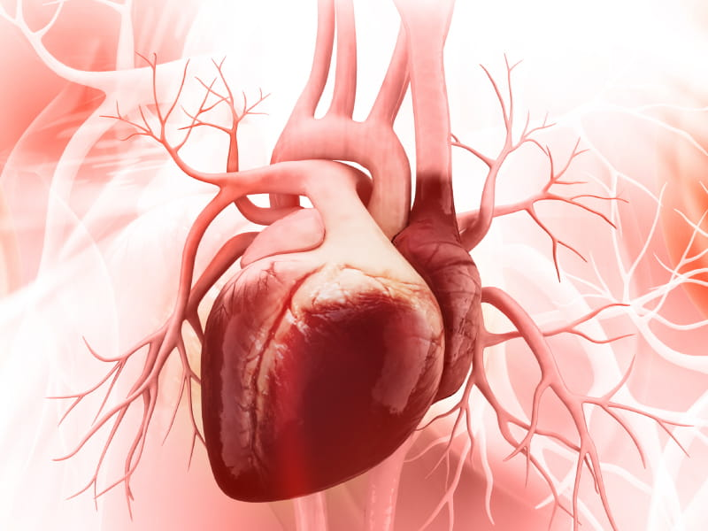
INTRODUCTION
1
Global heart disease concerns underscore the need for early prediction and intervention.
Deep learning, through intricate neural networks learning autonomously from extensive data, offers accurate predictions, resembling an intelligent system for complex pattern recognition.
Integrating deep learning into heart disease prediction holds potential for advancing medical care with its adeptness in pattern analysis.
11/14/2023
HEART DISEASE PREDICTION USING DEEP LEARNING

Slide 4
LITERATURE SURVEY
2
S.NO | TITLE | AUTHOR | PUBLICATION | DESCRIPTION | MERITS | DEMERITS
01 | Ischemic Heart Disease Prediction Using Optimized Squirrel Search Feature Selection Algorithm | D. Cenitta | 2022 | The provided algorithm is called the "Ischemic Heart Disease Multiple Imputation Technique." It is designed to handle missing attributes in a dataset (denoted as X) related to Ischemic Heart Disease. The algorithm performs multiple imputations to estimate and fill in the missing values in the dataset. It uses a nearest neighbor approach to find similar samples with non-missing attributes (denoted as N). For each missing attribute (denoted as a) in a sample (denoted as y), the algorithm computes two values (J1 and J2) based on the information from the nearest neighbors. If J2 is less than zero, it imputes the missing value using J1/J2; otherwise, it imputes the missing value using the mean of the non-missing values from the nearest neighbors. | Effective Handling of Missing Data Multiple imputations Nearest neighbor approach Flexibility | Complex Potential for overfitting Lack of Simplicity High Resource Demand Sensitivity to Hyperparameters Data Dependency
11/14/2023
HEART DISEASE PREDICTION USING DEEP LEARNING

Slide 5
LITERATURE SURVEY
3
S.NO | TITLE | AUTHOR | PUBLICATION | DESCRIPTION | MERITS | DEMERITS
02 | An Effective Heart Disease Prediction Model for a Clinical Decision Support System | Norma Latif Fitriyani | 2020 | The study introduces an innovative Heart Disease Prediction Model (HDPM) utilizing machine learning, outperforming six other algorithms in accuracy, precision, sensitivity, and more. With accuracy up to 98.40%, the HDPM demonstrates its potential to aid early detection and treatment, validated through statistical tests and a web-based Clinical Decision Support System for practical use in clinical settings. | Novel Approach Rigorous Performance Evaluation High Accuracy Robustness ROC Curve Analysis Statistical Significance Testing Practical Application Clinical Relevance Benchmarking with Previous Studies Contribution to Healthcare | Limited Dataset Lack of External Validation Missing Details on Model Hyperparameters Limited Clinical Trial Validation Comparison with More Advanced Techniques Lack of Ethical Considerations Overfitting Concerns Limited Feature Explanation No Long-term Impact Evaluation No Update on the State of the Art
11/14/2023
HEART DISEASE PREDICTION USING DEEP LEARNING

Slide 6
LITERATURE SURVEY
4
S.NO | TITLE | AUTHOR | PUBLICATION | DESCRIPTION | MERITS | DEMERITS
03 | Enhanced Deep Learning Assisted Convolutional Neural Network for Heart Disease Prediction on the Internet of Medical Things Platform | Yuanyuan Pan | 2020 | The paper presents an Enhanced Deep Learning Assisted Convolutional Neural Network (EDCNN) for the prediction of heart disease on the Internet of Medical Things (IoMT) platform. The IoMT platform utilizes various sensors to monitor heart-related parameters such as heart rate, blood pressure, and electrocardiogram (ECG) data. The EDCNN model is designed to leverage deep learning techniques and Convolutional Neural Networks (CNNs) for feature extraction and prediction. The goal is to enhance the prediction accuracy and efficiency of heart disease diagnosis using this approach. | Enhanced Prediction Accuracy Utilizing Internet of Medical Things Feature Extraction | Limited Description Dataset and Evaluation
11/14/2023
HEART DISEASE PREDICTION USING DEEP LEARNING

Slide 7
LITERATURE SURVEY
5
S.NO | TITLE | AUTHOR | PUBLICATION | DESCRIPTION | MERITS | DEMERITS
04 | An Optimally Configured and Improved Deep Belief Network (OCI-DBN) Approach for Heart Disease Prediction Based on Ruzzo–Tompa and Stacked Genetic Algorithm | Syed Arslan Ali | 2020 | The paper presents an OCI-DBN approach for heart disease prediction, aiming to overcome the challenges of overfitting, underfitting, and network optimization. The approach consists of two main components: a feature selection process using the Ruzzo-Tompa algorithm and a Deep Belief Network (DBN) configured using a Stacked Genetic Algorithm (SGA). The feature selection process aims to identify the most important and relevant features from the heart disease dataset, reducing complexity and computational time for the prediction system. The DBN is based on a Restricted Boltzmann Machine (RBM) and trained using a greedy layer-by-layer approach followed by fine-tuning with the backpropagation algorithm. The SGA is used to optimize the DBN's network configuration, including the number of layers, nodes, and hyperparameters. | Feature selection DBN architecture SGA for optimization. | Complex Approach Potential Overhead Lack of Simplicity High Resource Demand Sensitivity to Hyperparameters Data Dependency
11/14/2023
HEART DISEASE PREDICTION USING DEEP LEARNING

Slide 8
LITERATURE SURVEY
6
S.NO | TITLE | AUTHOR | PUBLICATION | DESCRIPTION | MERITS | DEMERITS
05 | Effective Heart Disease Prediction Using Hybrid Machine Learning Techniques | Senthilkumar Mohan | 2019 | The paper "Heart Disease Detection Using Hybrid Machine Learning" by N.-S. Tomov and S. Tomov presents the HRFLM method, combining Random Forest and Linear Methods, for improved heart disease prediction. Experiments on the Cleveland UCI dataset demonstrate HRFLM's accuracy superiority and potential for practical applications, emphasizing early detection's importance. | Use of Machine Learning Techniques Hybrid Approach HRFLM Feature Selection Using Entropy Benchmarking with Existing Models Exploration of Multiple Datasets Focus on Early Detection of Heart Disease Application of Machine Learning in Healthcare | Limited Detailed Methodology Insufficient Data Description Lack of Comparative Analysis Potential Overfitting Unclear Feature Selection Criteria Limited Explanation of Results Lack of External Validation
11/14/2023
HEART DISEASE PREDICTION USING DEEP LEARNING

Slide 9

EXISTING SYSTEM
7
The current method emphasizes a specific dataset with an 80% accuracy rate.
It uses an effective "10-Fold Cross Validation" for model training.
However, the existing complex approach, aiming to incorporate various methods and data processing step might slow down prediction.
Particularly with large datasets which demand significant computational resources it is purely a disadvantage.
11/14/2023
HEART DISEASE PREDICTION USING DEEP LEARNING

Slide 10

PROPOSED SYSTEM
8
The Automated Optimal Model Selection pipeline employs Grid Search, Random Search, cross-validation, and hyperparameter optimization to systematically fine-tune a range of neural network architectures for performance assessment.
Our Interpretable Deep Learning approach for Heart Disease Diagnosis combines attention mechanisms and LIME for transparent predictions, utilizing Convolutional and Recurrent Neural Networks with attention, alongside XGBoost integrated with LIME for model interpretability.
Our Comparative Analysis of Ensemble Models rigorously compares deep learning methods with traditional ensembles, assessing accuracy, sensitivity, specificity, and more on varied datasets to elucidate the strengths and constraints of each approach.
11/14/2023
HEART DISEASE PREDICTION USING DEEP LEARNING

Slide 11

Software and Hardware Requirements
9
Hardware Requirement(Minimum):
RAM – 4GB
Processor – Core i3
Software Requirement:
OS – Windows 10 or above
Py charm
VS code
Stream line
11/14/2023
HEART DISEASE PREDICTION USING DEEP LEARNING

Slide 12
Architecture Design
10
4 Datasets
(Cleveland, Hungarian, Long-Beach, Switzerland)
Heart Disease Prediction
K – nearest Neighbour
LIME
RNN
XG Boosting
Ensemble
DEEP LEARNING
Proposed Model
Data Preprocessing
Missing Values Imputations
Standardization
Outliner detection and elimination
Duplicates removal
Database update
Training Data
10 – fold cross validation
Generate Model
Test Data
Dense Neural Network
11/14/2023
HEART DISEASE PREDICTION USING DEEP LEARNING

Slide 13

Algorithms Used
11
Automated Optimal Model Selection Pipeline
Grid search
Cross – Validation
Hyperparameter Optimization
Interpretable Deep Learning for Heart Disease Diagnosis
Local Interpretable Model-agnostic Explanations (LIME)
XG Boost
Comparative Analysis of Ensemble Models
Recurrent Neural Networks (RNN)
Traditional Ensembles
11/14/2023
HEART DISEASE PREDICTION USING DEEP LEARNING

Slide 14
Expected Outcome
12
0 – Healthy Patient
1 – Patient Vulnerable to Heart Disease (also gives the cause)
11/14/2023
HEART DISEASE PREDICTION USING DEEP LEARNING

Slide 15
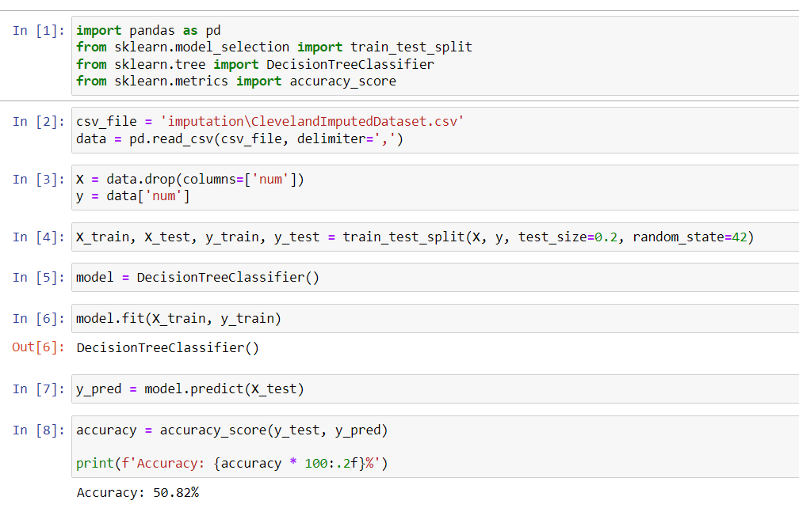
Comparison of Accuracy
12
Cleveland dataset gives 50.82% of accuracy before performing standardization when performed decision tree algorithm
11/14/2023
HEART DISEASE PREDICTION USING DEEP LEARNING

Slide 16
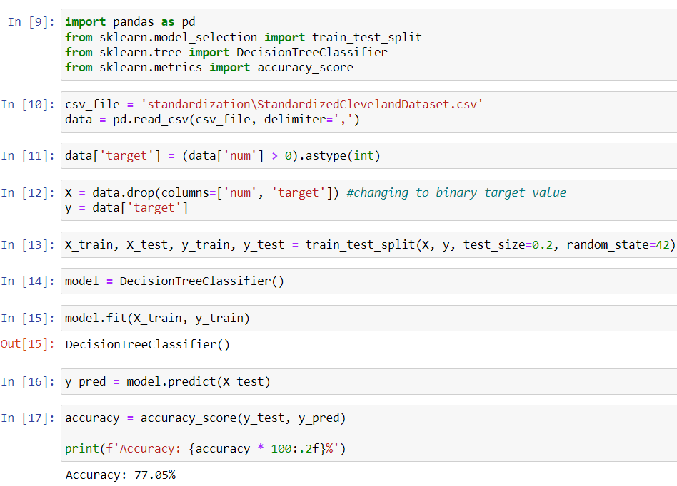
Comparison of Accuracy
12
Same Cleveland dataset gives 77.05% of accuracy after performing standardization when performed decision tree algorithm
11/14/2023
HEART DISEASE PREDICTION USING DEEP LEARNING

Slide 17
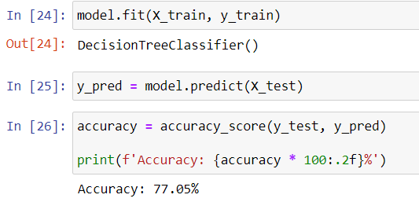
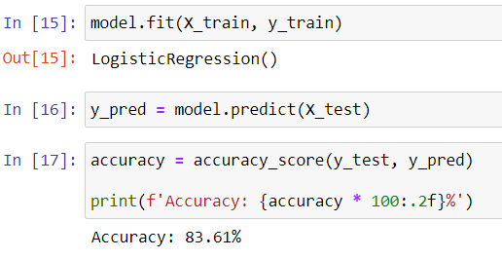
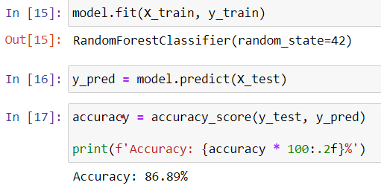
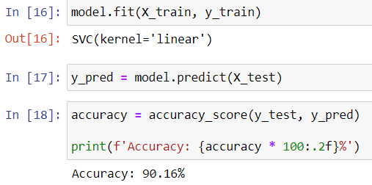
Comparison of Algorithms after standardization
12
11/14/2023
HEART DISEASE PREDICTION USING DEEP LEARNING

Slide 18
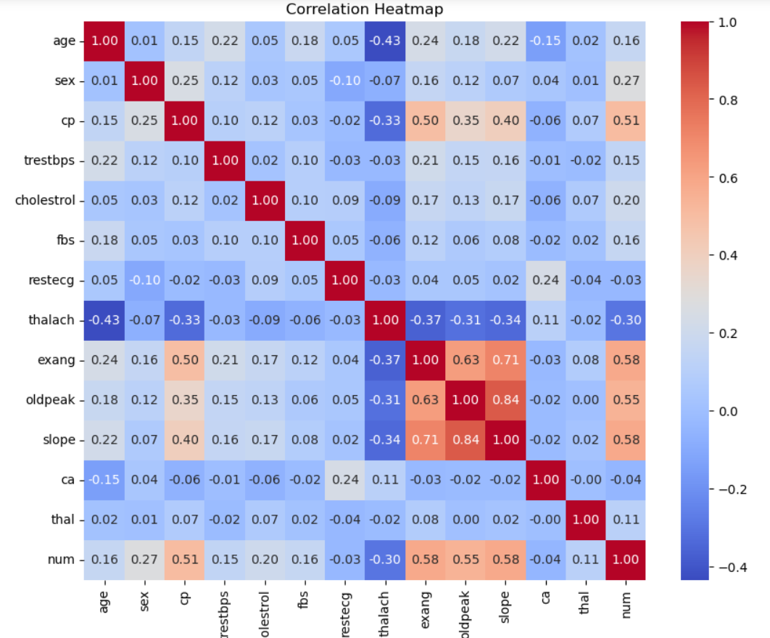
DATA VISUALIZATION
12
HEAT MAP
of
Cleaveland dataset
11/14/2023
HEART DISEASE PREDICTION USING DEEP LEARNING

Slide 19
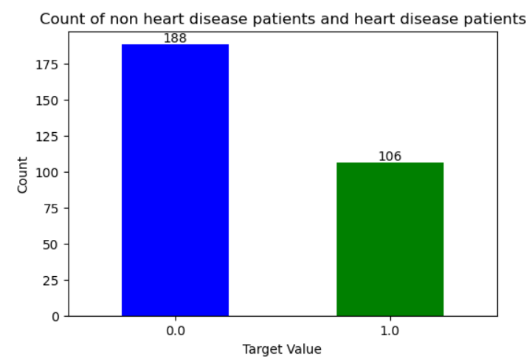
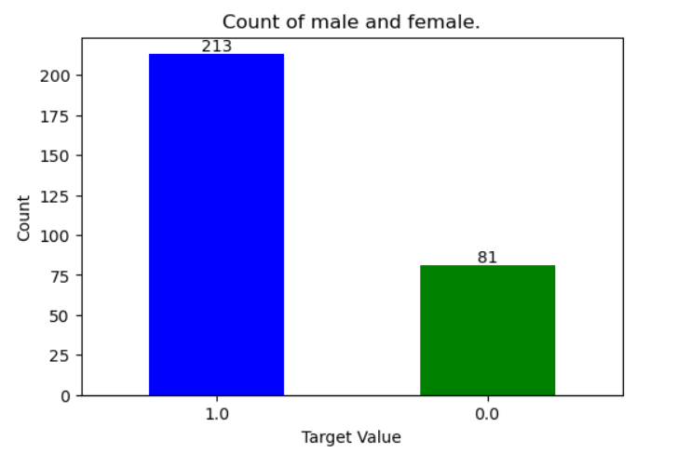
DATA VISUALIZATION
12
11/14/2023
HEART DISEASE PREDICTION USING DEEP LEARNING

Slide 20
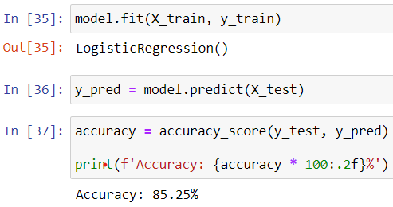
Logistic Regression
12
Before Pre Processing After Pre Processing
11/14/2023
HEART DISEASE PREDICTION USING DEEP LEARNING

Slide 21
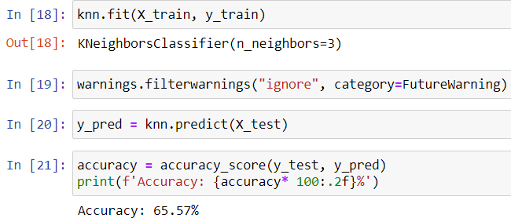
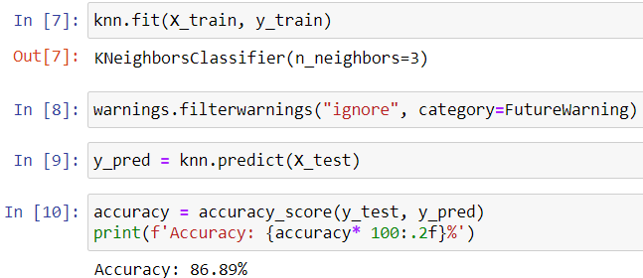
KNN
12
Before Pre Processing After Pre Processing
11/14/2023
HEART DISEASE PREDICTION USING DEEP LEARNING

Slide 22
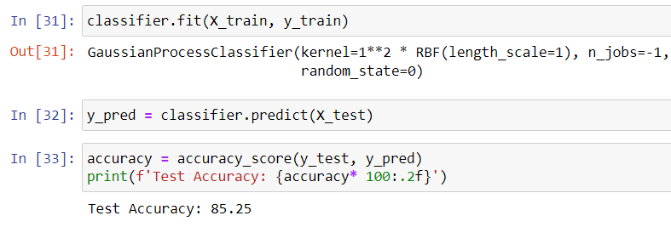
Gaussian Process
12
Before Pre Processing After Pre Processing
11/14/2023
HEART DISEASE PREDICTION USING DEEP LEARNING

Slide 23
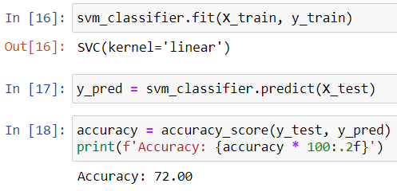
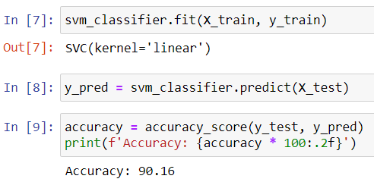
SVM
12
Before Pre Processing After Pre Processing
11/14/2023
HEART DISEASE PREDICTION USING DEEP LEARNING

Slide 24
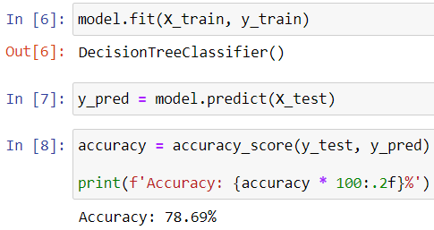
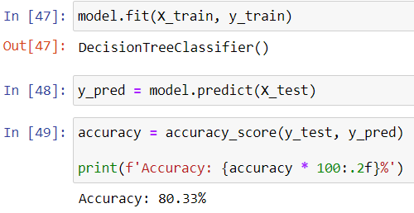
Decision Tree
12
Before Pre Processing After Pre Processing
11/14/2023
HEART DISEASE PREDICTION USING DEEP LEARNING

Slide 25
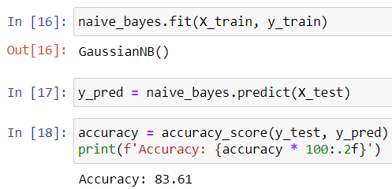
Naïve Bayes
12
Before Pre Processing After Pre Processing
11/14/2023
HEART DISEASE PREDICTION USING DEEP LEARNING

Slide 26
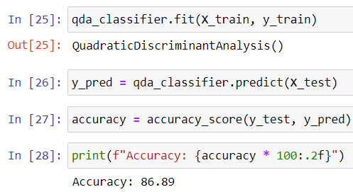
QDA
12
Before Pre Processing After Pre Processing
11/14/2023
HEART DISEASE PREDICTION USING DEEP LEARNING

Slide 27
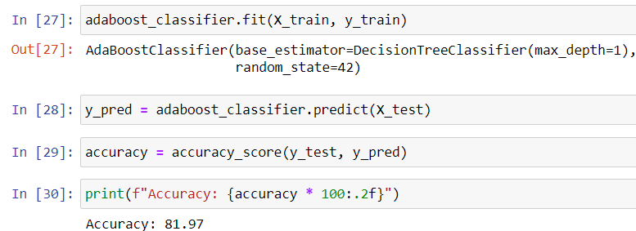
AdaBoost
12
Before Pre Processing After Pre Processing
11/14/2023
HEART DISEASE PREDICTION USING DEEP LEARNING

Slide 28
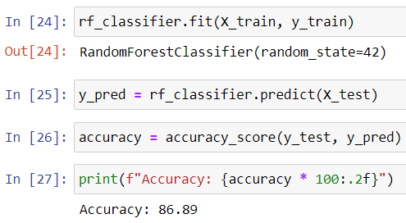
Bagging Classifier
12
Before Pre Processing After Pre Processing
11/14/2023
HEART DISEASE PREDICTION USING DEEP LEARNING

Slide 29
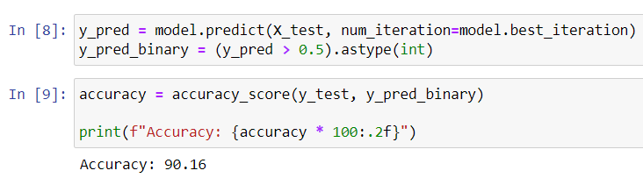
Boosting
12
Before Pre Processing After Pre Processing
11/14/2023
HEART DISEASE PREDICTION USING DEEP LEARNING

Slide 30
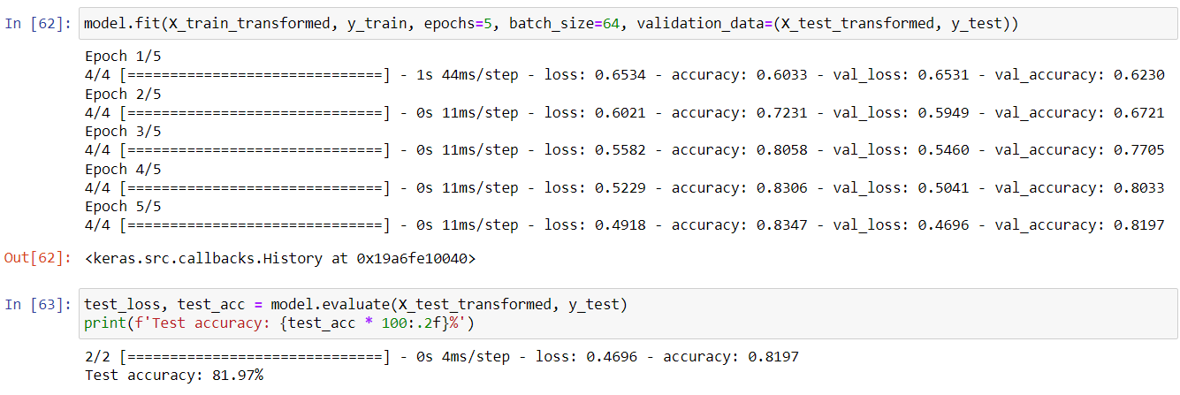
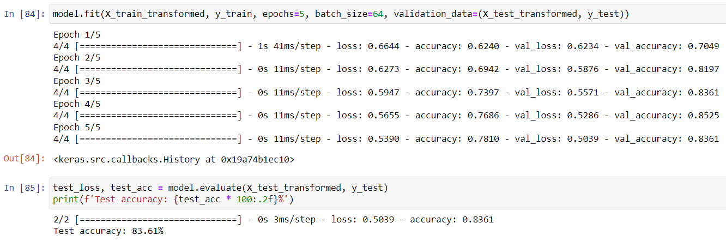
Deep Neural Networks
12
Before Pre Processing After Pre Processing
11/14/2023
HEART DISEASE PREDICTION USING DEEP LEARNING

Slide 31
GANTT CHART
13
 | AUGUST 2023 | SEPTEMBER 2023 | OCTOBER 2023 | NOVEMBER 2023
Project analysis And planning
Gathering Data
Analysing Data
Train Module
Training and Testing Model
11/14/2023
HEART DISEASE PREDICTION USING DEEP LEARNING

Slide 32
REFERENCE
14
[1] N.-S. Tomov and S. Tomov, ‘‘On deep neural networks for detecting heart disease,’’ 2018, arXiv:1808.07168.
[2] World Heath Organization. (Jun. 7, 2014). Cardio Vascular Diseases (CVDs). [Online]. Available: http://www.who.int/news-room/factsheets/detail/cardiovascular-diseases-(cvds)
[3] Worldlifeexpectancy. (2014). World Health Ranikngs Live Longer Live Better. [Online]. Available: http://www.worldlifeexpectancy.com/causeof-death/coronary-heart-disease/by-country/
[4] C. Sowmiya and P. Sumitra, ‘‘Analytical study of heart disease diagnosis using classification techniques,’’ in Proc. IEEE Int. Conf. Intell. Techn. Control, Optim. Signal Process. (INCOS), Mar. 2017, pp. 1–5.
[5] A. Kumar, P. Kumar, A. Srivastava, V. D. A. Kumar, K. Vengatesan, and A. Singhal, ‘‘Comparative analysis of data mining techniques to predict heart disease for diabetic patients,’’ in Proc. Int. Conf. Adv. Comput. Data Sci. Singapore: Springer, 2020, pp. 507–518.
[6] Y -J. Huang, M. Parry, Y. Zeng, Y. Luo, J. Yang, and G.-P. He, ‘‘Examination of a nurse-led community-based education and coaching intervention for coronary heart disease high-risk individuals in China,’’ Asian Nursing Res., vol. 11, no. 3, pp. 187–193, Sep. 2017.
[7] R. Hasan, ‘‘Comparative analysis of machine learning algorithms for heart disease prediction,’’ in Proc. ITM Web Conf., vol. 40, 2021, p. 03007.
[8] S. Khan and S. T. Rasool, ‘‘Current use of cardiac biomarkers in various heart conditions,’’ Endocrine, Metabolic Immune Disorders-Drug Targets, vol. 21, no. 6, pp. 980–993, Jun. 2021.
[9] S. Bashir, A. A. Almazroi, S. Ashfaq, A. A. Almazroi, and F. H. Khan, ‘‘A knowledge-based clinical decision support system utilizing an intelligent ensemble voting scheme for improved cardiovascular disease prediction,’’ IEEE Access, vol. 9, pp. 130805–130822, 2021.
[10] S. Bashir, U. Qamar, and F. H. Khan, ‘‘BagMOOV: A novel ensemble for heart disease prediction bootstrap aggregation with multi-objective optimized voting,’’ Australas. Phys. Eng. Sci. Med., vol. 38, no. 2, pp. 305–323, Jun. 2015.
11/14/2023
HEART DISEASE PREDICTION USING DEEP LEARNING

Slide 33
REFERENCE
15
[11] V. Vives-Boix, D. Ruiz-Fernández, A. de Ramón-Fernández, D. Marcos-Jorquera, and V. Gilart-Iglesias, ‘‘A knowledge-based clinical decision support system for monitoring chronic patients,’’ in Proc. Int. Work-Conf. Interplay Between Natural Artif. Comput. Cham, Switzerland: Springer, 2017, pp. 435–443.
[12] S. Bashir, Z. S. Khan, F. Hassan Khan, A. Anjum, and K. Bashir, ‘‘Improving heart disease prediction using feature selection approaches,’’ in Proc. 16th Int. Bhurban Conf. Appl. Sci. Technol. (IBCAST), Jan. 2019, pp. 619–623
[13] A. J. Aljaaf, D. Al-Jumeily, A. J. Hussain, P. Fergus, M. Al-Jumaily, and K. Abdel-Aziz, ‘‘Toward an optimal use of artificial intelligence techniques within a clinical decision support system,’’ in Proc. Sci. Inf. Conf. (SAI), Jul. 2015, pp. 548–554.
[14] K. Chitra and D. Maheswari, ‘‘A comparative study of various clustering algorithms in data mining,’’ Int. J. Comput. Sci. Mobile Comput., vol. 6, no. 8, pp. 109–115, 2017.
[15] Y. Wang, H. Yao, and S. Zhao, ‘‘Auto-encoder based dimensionality reduction,’’ Neurocomputing, vol. 184, pp. 232–242, Apr. 2016.
[16] M. P. T. Kaandorp, S. Barbieri, R. Klaassen, H. W. M. Laarhoven, H. Crezee, P. T. While, A. J. Nederveen, and O. J. Gurney-Champion, ‘‘Improved unsupervised physics-informed deep learning for intravoxel incoherent motion modeling and evaluation in pancreatic cancer patients,’’ Magn. Reson. Med., vol. 86, no. 4, pp. 2250–2265, Oct. 2021.
[17] The Enterprisers Project. Accessed: Dec. 25, 2022. [Online]. Available: https://enterprisersproject.com/article/2019/7/deep-learning-explainedplain.
[18] M. A. Khan, ‘‘An IoT framework for heart disease prediction based on MDCNN classifier,’’ IEEE Access, vol. 8, pp. 34717–34727, 2020.
[19] M. A. Khan and F. Algarni, ‘‘A healthcare monitoring system for the diagnosis of heart disease in the IoMT cloud environment using MSSOANFIS,’’ IEEE Access, vol. 8, pp. 122259–122269, 2020.
[20] M. A. Khan, M. T. Quasim, N. S. Alghamdi, and M. Y. Khan, ‘‘A secure framework for authentication and encryption using improved ECC for IoTbased medical sensor data,’’ IEEE Access, vol. 8, pp. 52018–52027, 2020.
11/14/2023
HEART DISEASE PREDICTION USING DEEP LEARNING

Slide 34
REFERENCE
16
[21] S. Chae, S. Kwon, and D. Lee, ‘‘Predicting infectious disease using deep learning and big data,’’ Int. J. Environ. Res. Public Health, vol. 15, no. 8, p. 1596, Jul. 2018.
[22] M. Raju, V. Pagidimarri, R. Barreto, A. Kadam, V. Kasivajjala, and A. Aswath, ‘‘Development of a deep learning algorithm for automatic diagnosis of diabetic retinopathy,’’ in Proc. MEDINFO, 2017, pp. 559–563.
[23] G. T. Reddy and N. Khare, ‘‘An efficient system for heart disease prediction using hybrid OFBAT with rule-based fuzzy logic model,’’ J. Circuits, Syst. Comput., vol. 26, no. 4, Apr. 2017, Art. no. 1750061.
[24] N. Khateeb and M. Usman, ‘‘Efficient heart disease prediction system using K-nearest neighbor classification technique,’’ in Proc. Int. Conf. Big Data Internet Thing, Dec. 2017, pp. 21–26.
[25] L. Verma, S. Srivastava, and P. C. Negi, ‘‘A hybrid data mining model to predict coronary artery disease cases using non-invasive clinical data,’’ J. Med. Syst., vol. 40, no. 7, p. 178, Jul. 2016.
[26] A. H. Chen, S. Y. Huang, P. S. Hong, C. H. Cheng, and E. J. Lin, ‘‘HDPS: Heart disease prediction system,’’ in Proc. Comput. Cardiol., Sep. 2011, pp. 557–560.
[27] M. A. Jabbar and S. Samreen, ‘‘Heart disease prediction system based on hidden naïve Bayes classifier,’’ in Proc. Int. Conf. Circuits, Controls, Commun. Comput. (I4C), Oct. 2016, pp. 1–5.
[28] K. Srinivas, B. K. Rani, and A. Govrdhan, ‘‘Applications of data mining techniques in healthcare and prediction of heart attacks,’’ Int. J. Data Mining Techn. Appl., vol. 7, no. 1, pp. 172–176, Mar. 2018.
[29] R. Chitra and V. Seenivasagam, ‘‘Heart attack prediction system using cascaded neural network,’’ in Proc. Int. Conf. Appl. Math. Theor. Comput. Sci., 2013, p. 223.
[30] T. Helmy, S. M. Rahman, M. I. Hossain, and A. Abdelraheem, ‘‘Nonlinear heterogeneous ensemble model for permeability prediction of oil reservoirs,’’ Arabian J. Sci. Eng., vol. 38, no. 6, pp. 1379–1395, Jun. 2013.
11/14/2023
HEART DISEASE PREDICTION USING DEEP LEARNING

Slide 35
REFERENCE
17
[31] A. Singh and R. Kumar, ‘‘Heart disease prediction using machine learning algorithms,’’ in Proc. Int. Conf. Electr. Electron. Eng., Feb. 2020, pp. 452–457.
[32] S. Maji and S. Arora, ‘‘Decision tree algorithms for prediction of heart disease,’’ in Information and Communication Technology for Competitive Strategies. Singapore: Springer, 2019, pp. 447–454.
[33] A. Chauhan, A. Jain, P. Sharma, and V. Deep, ‘‘Heart disease prediction using evolutionary rule learning,’’ in Proc. 4th Int. Conf. Comput. Intell. Commun. Technol. (CICT), Feb. 2018, pp. 1–4.
[34] P. Sharma, K. Saxena, and R. Sharma, ‘‘Heart disease prediction system evaluation using C4.5 rules and partial tree,’’ in Computational Intelligence in Data Mining, vol. 2. New Delhi, India: Springer, 2016, pp. 285–294.
[35] S. Bashir, U. Qamar, and M. Y. Javed, ‘‘An ensemble based decision support framework for intelligent heart disease diagnosis,’’ in Proc. Int. Conf. Inf. Soc., Nov. 2014, pp. 259–264.
[36] A. A. Almazroi, H. Alamin, R. Sujatha, and N. Z. Jhanjhi, ‘‘A web-based model to predict a neurological disorder using ANN,’’ Healthcare, vol. 10, no. 8, p. 1474, Aug. 2022.
[37] M. H. Alkinani, A. A. Almazroi, M. Adhikari, and V. G. Menon, ‘‘Design and analysis of logistic agent-based swarm-neural network for intelligent transportation system,’’ Alexandria Eng. J., vol. 61, no. 10, pp. 8325–8334, Oct. 2022.
[38] D. Hassan, H. I. Hussein, and M. M. Hassan, ‘‘Heart disease prediction based on pre-trained deep neural networks combined with principal component analysis,’’ Biomed. Signal Process. Control, vol. 79, Jan. 2023, Art. no. 104019.
[39] P. Dileep, K. N. Rao, P. Bodapati, S. Gokuruboyina, R. Peddi, A. Grover, and A. Sheetal, ‘‘An automatic heart disease prediction using cluster-based bi-directional LSTM (C-BiLSTM) algorithm,’’ Neural Comput. Appl., vol. 35, no. 10, pp. 7253–7266, Apr. 2023.
[40] M. Ijaz, G. Alfian, M. Syafrudin, and J. Rhee, ‘‘Hybrid prediction model for type 2 diabetes and hypertension using DBSCAN-based outlier detection, synthetic minority over sampling technique (SMOTE), and random forest,’’ Appl. Sci., vol. 8, no. 8, p. 1325, Aug. 2018, doi: 10.3390/app8081325.
11/14/2023
HEART DISEASE PREDICTION USING DEEP LEARNING

Slide 36
REFERENCE
18
[41] G. Alfian, M. Syafrudin, and J. Rhee, ‘‘Real-time monitoring system using smartphone-based sensors and NoSQL database for perishable supply chain,’’ Sustainability, vol. 9, no. 11, p. 2073, Nov. 2017, doi: 10.3390/su9112073.
[42] M. Syafrudin, G. Alfian, N. Fitriyani, and J. Rhee, ‘‘Performance analysis of IoT-based sensor, big data processing, and machine learning model for real-time monitoring system in automotive manufacturing,’’ Sensors, vol. 18, no. 9, p. 2946, Sep. 2018, doi: 10.3390/s18092946.
[43] M. Syafrudin, N. Fitriyani, G. Alfian, and J. Rhee, ‘‘An affordable fast early warning system for edge computing in assembly line,’’ Appl. Sci., vol. 9, no. 1, p. 84, Dec. 2018, doi: 10.3390/app9010084.
[44] G. Lemaitre, F. Nogueira, and C. K. Aridas, ‘‘Imbalanced-learn: A Python toolbox to tackle the curse of imbalanced datasets in machine learning,’’ J. Mach. Learn. Res., vol. 18, no. 1, pp. 559–563, Jan. 2017.
[45] T. Chen and C. Guestrin, ‘‘XGBoost: A scalable tree boosting system,’’ in Proc. 22nd ACM SIGKDD Int. Conf. Knowl. Discovery Data Mining, San Francisco, CA, USA, Aug. 2016, pp. 785–794, doi: 10.1145/2939672.2939785.
[46] C. Marrocco, R. P. W. Duin, and F. Tortorella, ‘‘Maximizing the area under the ROC curve by pairwise feature combination,’’ Pattern Recognit., vol. 41, no. 6, pp. 1961–1974, Jun. 2008, doi: 10.1016/ j.patcog.2007.11.017.
[47] K.-A. Toh, J. Kim, and S. Lee, ‘‘Maximizing area under ROC curve for biometric scores fusion,’’ Pattern Recognit., vol. 41, no. 11, pp. 3373–3392, Nov. 2008, doi: 10.1016/j.patcog.2008.04.002.
[48] S. H. Jee et al., ‘‘A coronary heart disease prediction model: The korean heart study,’’ BMJ Open, vol. 4, no. 5, May 2014, Art. no. e005025, doi: 10.1136/bmjopen-2014-005025.
[49] G. T. Reddy, M. P. K. Reddy, K. Lakshmanna, D. S. Rajput, R. Kaluri, and G. Srivastava, ‘‘Hybrid genetic algorithm and a fuzzy logic classifier for heart disease diagnosis,’’ Evol. Intell., vol. 13, no. 2, pp. 185–196, Nov. 2019, doi: 10.1007/s12065-019-00327-1.
[50] B. R. Kirkwood, J. A. C. Sterne, and B. R. Kirkwood, Essential Medical Statistics, 2nd ed. Malden, MA, USA: Blackwell Science, 2003.
11/14/2023
HEART DISEASE PREDICTION USING DEEP LEARNING

Slide 37
THANK YOU

